Slide 1
9. Statistics

Slide 2
9. Statistics
Codes and Data are available on:
https://www.elsevier.com/books-and-journals/book-companion/9780081029398

Slide 3
9. Statistics
Descriptive Statistics:
Uni-variate
Inferential Analysis
Basic Concepts
Experimental Design and Sample Size Calculations
Bi-variate
Regression Analysis
ROC Analysis
Parametric Hypothesis Testing
Non-Parametric Hypothesis Testing
Multiple and Multivariate Hypothesis Testing
Statistical Shape Models

Slide 5
Descriptive Statistics

Slide 6
Descriptive Statistics - Basic Concepts
Terms
Data Population Sample Variable
Statistical Variables
Uni-Variate Bi-Variate Multi-Variate
Statistical Data Types
Categorical Ranked Discrete Continuous

Slide 7
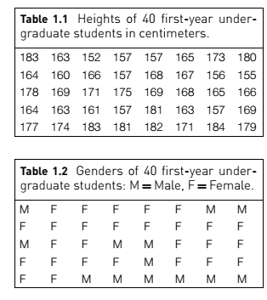
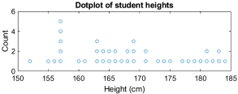
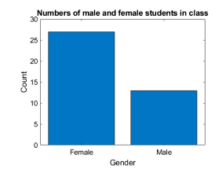
Descriptive Statistics - Univariate Data Visualization

Slide 8
Descriptive Statistics - Histogram

Slide 9
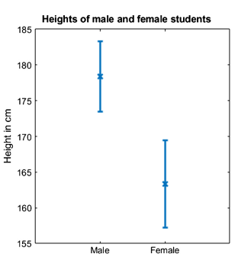
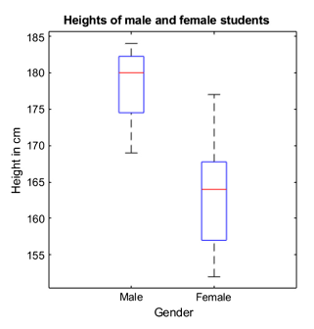
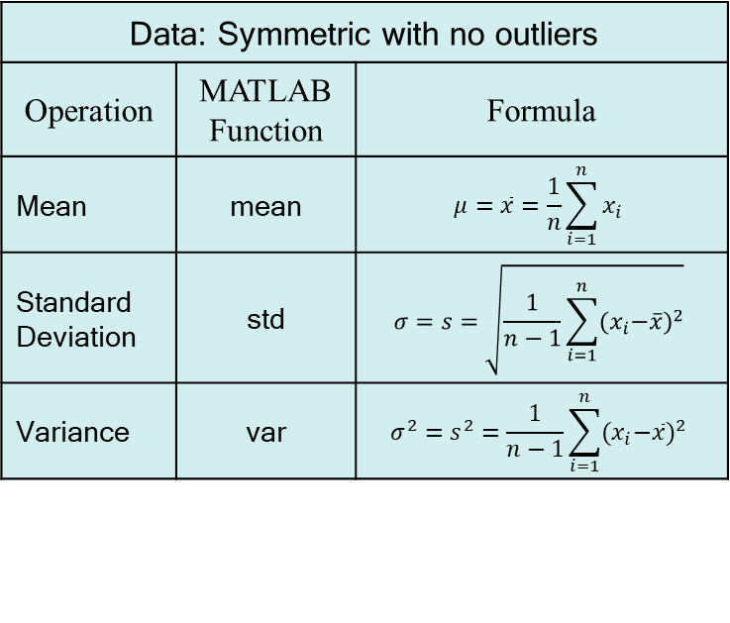
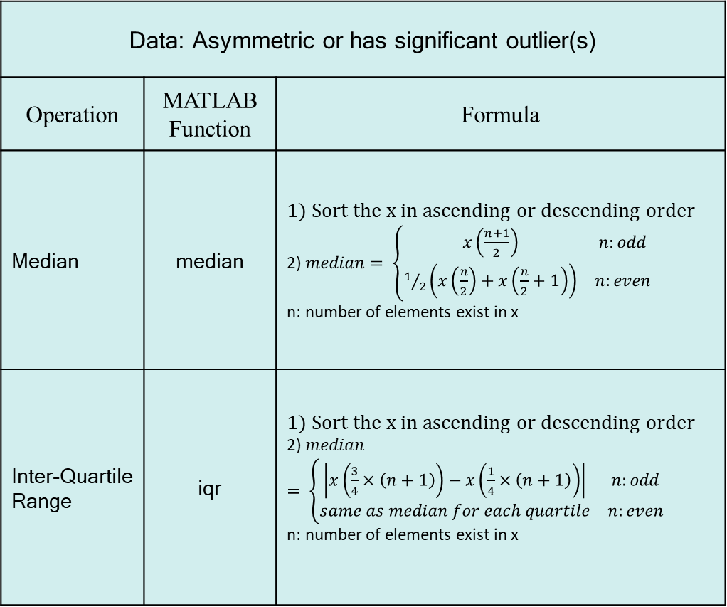
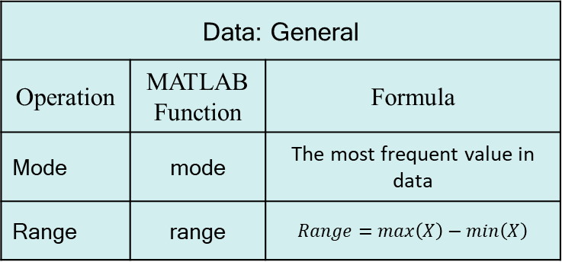
Descriptive Statistics - Univariate Data Measures
Data: General
Operation | MATLAB Function | Formula
Mode | mode | The most frequent value in data
Range | range | $$Range=max\left(X\right)−min\left(X\right)$$
Data: Asymmetric or has significant outlier(s) | Univariate Statistics
Operation | MATLAB Function | Formula
Median | median | 1) Sort the x in ascending or descending order 2) $median= \left\{\begin{matrix}x\left(\frac{n+1}{2}\right) & n:odd \\ 1/2\left(x\left(\frac{n}{2}\right)+x\left(\frac{n}{2}+1\right)\right) & n:even\end{matrix}\right.$ n: number of elements exist in x
Inter-Quartile Range | iqr | 1) Sort the x in ascending or descending order 2) $median= \left\{\begin{matrix}\left|x\left(\frac{3}{4}×\left(n+1\right)\right)−x\left(\frac{1}{4}×\left(n+1\right)\right)\right| & n:odd \\ same as median for each quartile & n:even\end{matrix}\right.$ n: number of elements exist in x
Data: Symmetric with no outliers
Operation | MATLAB Function | Formula
Mean | mean | $$μ=\overline{x}=\frac{1}{n}\sum_{i=1}^{n}{x_{i}}$$
Standard Deviation | std | $$σ=s=\sqrt{\frac{1}{n−1}\sum_{i=1}^{n}{{{(x}_{i}−\overline{x})}^{2}}}$$
Variance | var | $${σ^{2}=s}^{2}=\frac{1}{n−1}\sum_{i=1}^{n}{{{(x}_{i}−\overline{x})}^{2}}$$

Slide 10
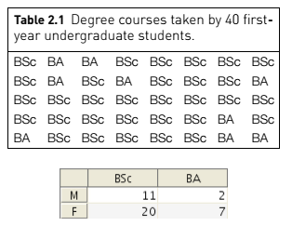
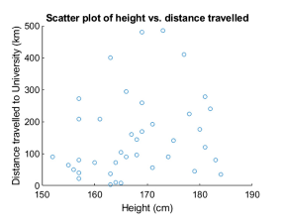
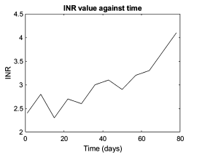
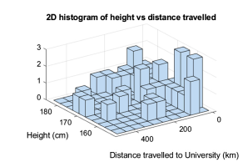
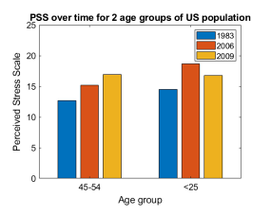
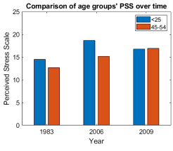
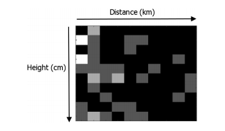
Descriptive Statistics - Bivariate Data Visualization

Slide 11
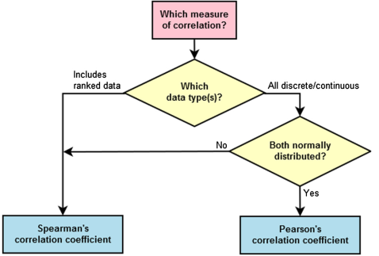
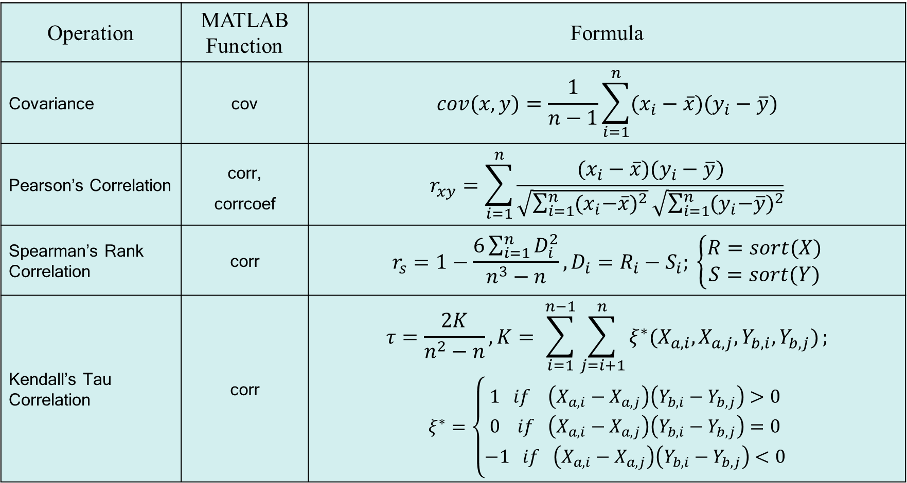
Descriptive Statistics - Bivariate Data Measures
Operation | MATLAB Function | Formula
Covariance | cov | $$cov(x,y)=\frac{1}{n−1}\sum_{i=1}^{n}{(x_{i}−\overline{x})(y_{i}−\overline{y})}$$
Pearson’s Correlation | corr, corrcoef | $$r_{xy}=\sum_{i=1}^{n}{\frac{(x_{i}−\overline{x})(y_{i}−\overline{y})}{\sqrt{\sum_{i=1}^{n}{{{(x}_{i}−\overline{x})}^{2}}}\sqrt{\sum_{i=1}^{n}{{{(y}_{i}−\overline{y})}^{2}}}}}$$
Spearman’s Rank Correlation | corr | $$r_{s}=1−\frac{6\sum_{i=1}^{n}{D_{i}^{2}}}{n^{3}−n}, D_{i}=R_{i}−S_{i}; \left\{\begin{aligned}R=sort(X) \\ S=sort(Y)\end{aligned}\right.$$
Kendall’s Tau Correlation | corr | $$τ=\frac{2K}{n^{2}−n}, K= \sum_{i=1}^{n−1}{\sum_{j=i+1}^{n}{ξ^{∗}(X_{a,i},X_{a,j},Y_{b,i},Y_{b,j})}};$$ $$ξ^{∗}=\left\{\begin{aligned}1 if \left(X_{a,i}−X_{a,j}\right)\left(Y_{b,i}−Y_{b,j}\right)>0 \\ 0 if \left(X_{a,i}−X_{a,j}\right)\left(Y_{b,i}−Y_{b,j}\right)=0 \\ −1 if \left(X_{a,i}−X_{a,j}\right)\left(Y_{b,i}−Y_{b,j}\right)<0\end{aligned}\right.$$

Slide 12
P-Value

Slide 13
Descriptive Statistics - Regression Analysis
polyfit
polyval

Slide 14

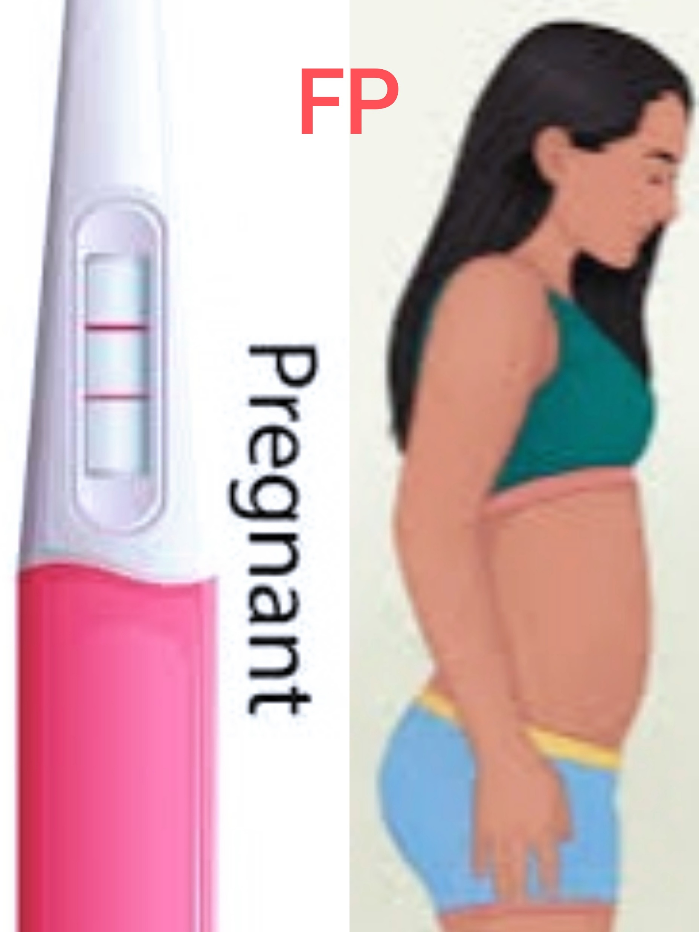
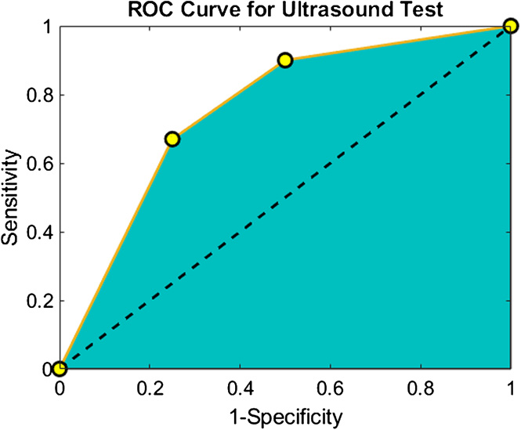


Descriptive Statistics – ROC Analysis
True Positive (TP) | False Positive (FP)
False Negative (FN) | True Negative (TN)
Accuracy | Ac = (TP+TN)/(TP+FP+TN+FN)
Sensitivity | Se = TP/(TP+FN)
Specificity | Sp = TN/(TN+FP) = 1- FPR
Positive Predictive Value (Precision) | PPV = TP/(TP + FP)
Negative Predictive Value | NPV = TN/(TN + FN)
False Positive Rate | FPR = FP/(FP+TN) = 1 - Sp
Recall | Re = TP/(TP+FN)
F1 Score | F1 = 2TP/(2TP+FP+FN)

Slide 15
Inferential Statistics

Slide 16
Inferential Statistics - Basic Concepts
Probability
Single Event
Multiple Events
Probability Distribution
Normal Distribution
The Central Limit Theorem
Standard Error Of The Mean
Confidence Intervals Of The Mean

Slide 17
Inferential Statistics - Parametric Hypothesis Testing
Hypothesis
Null Hypothesis
Alternative Hypothesis
Type I Error
Type II Error
Hypothesis Testing
One sample.
Two-sample paired data.
Two-sample unpaired data
t-Distribution Test & Student’s t-Test
z-Test

Slide 18
Inferential Statistics - Non-Parametric Hypothesis Testing
Sign Test
Wilcoxon Signed Rank Test
Mann–Whitney U Test
Chi-Square Test
Choosing a Hypothesis Test

Slide 19
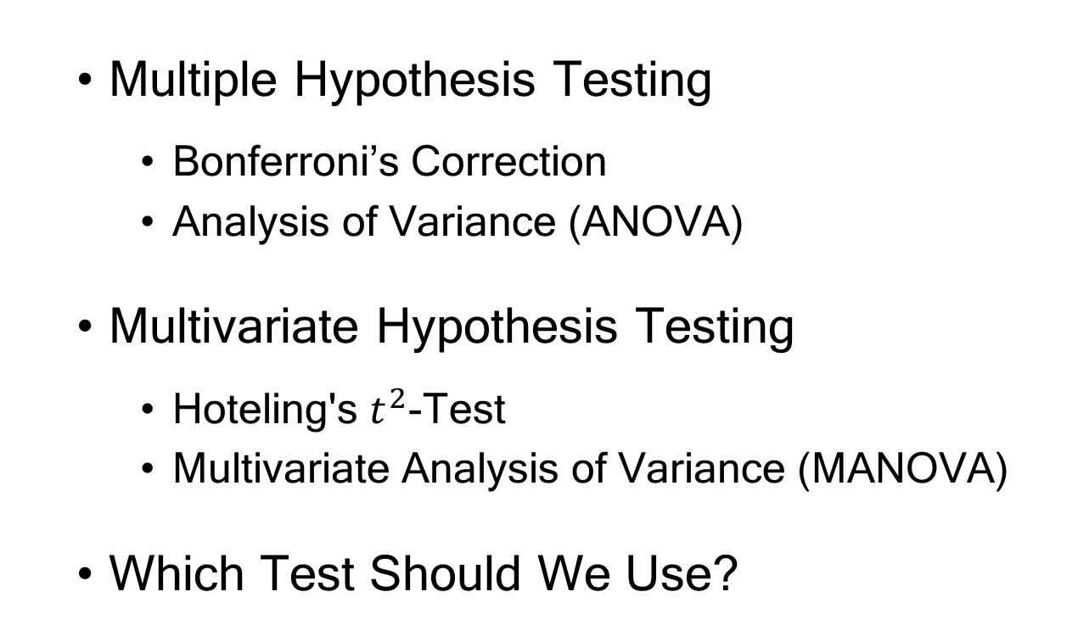
Inferential Statistics - Multiple and Multivariate Hypothesis Testing
Multiple Hypothesis Testing
Bonferroni’s Correction
Analysis of Variance (ANOVA)
Multivariate Hypothesis Testing
Hoteling's $t^{2}$-Test
Multivariate Analysis of Variance (MANOVA)
Which Test Should We Use?

Slide 20
Complementary Topics

Slide 21
Inferential Statistics - Experimental Design and Sample Size Calculations
Experimental And Observational Studies
Random And Systematic Error (Bias)
Reducing Random And Systematic Errors
Blocking (Matching) Test and Control Subjects
Blinding
Multiple Measurement
Randomization
Sample Size And Power Calculations
Illustration of a Power Calculation for a Single Sample t-test
Illustration of a Sample Size Calculation

Slide 22
Inferential Statistics - Statistical Shape Models (SSMs)
SSMs And Dimensionality Reduction
Forming An SSM
Parameterize the Shape
Align the Centroids
Compute the Mean Shape Vector
Compute the Covariance Matrix
Compute the Eigenvectors and Eigenvalues
Producing New Shapes From An SSM

Slide 23
Supplementary Topics

Slide 24
Some Statistical Plots
cdfplot
ecdf
probplot
normplot
wblplot
qqplot

Slide 25
Inferential Statistics - Probability Distributions

